Slide 1

This Flex.Rmd was created with simulated data from the Oregon Extended Assessment (ORExt).
The ORExt is Oregon’s Alternate Assessment for Individuals with Significant Cognitive Disabilities.

Slide 2
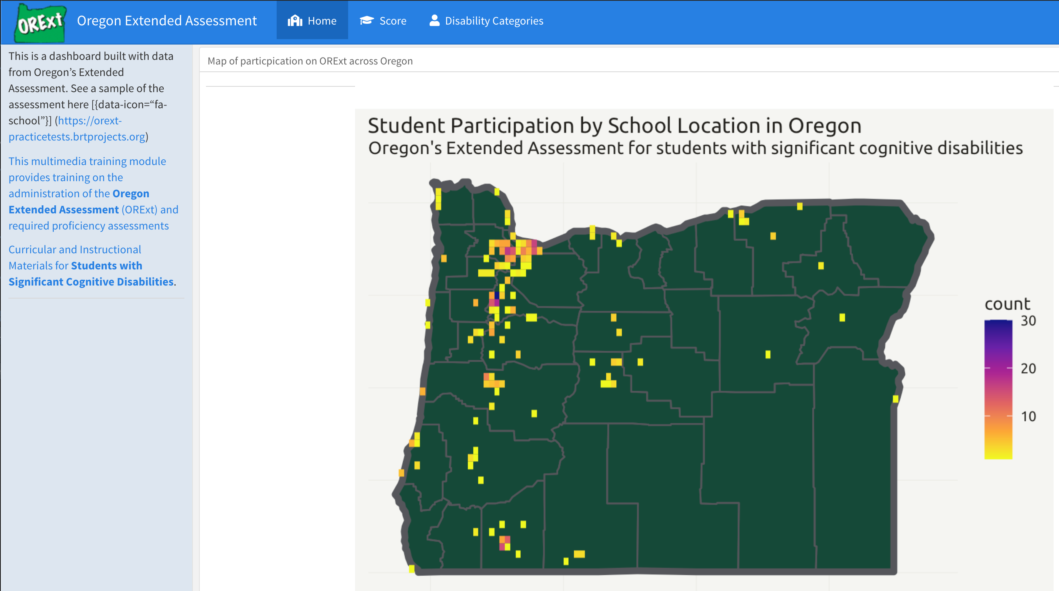
Briefly show each visualization

Slide 3
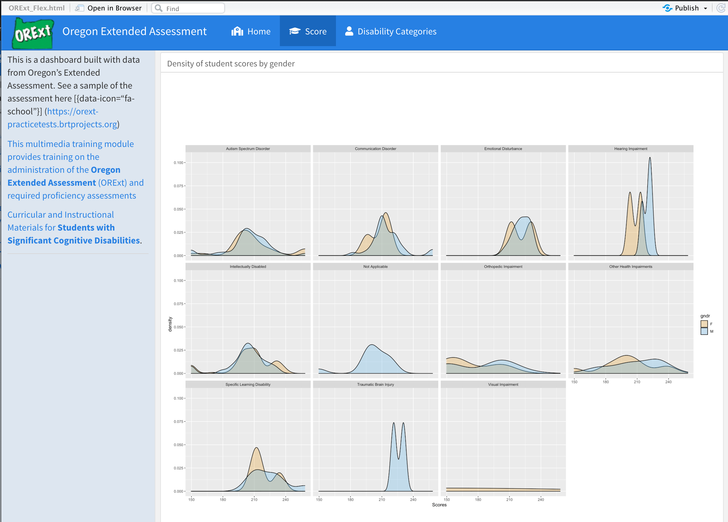
Briefly show each visualization

Slide 4
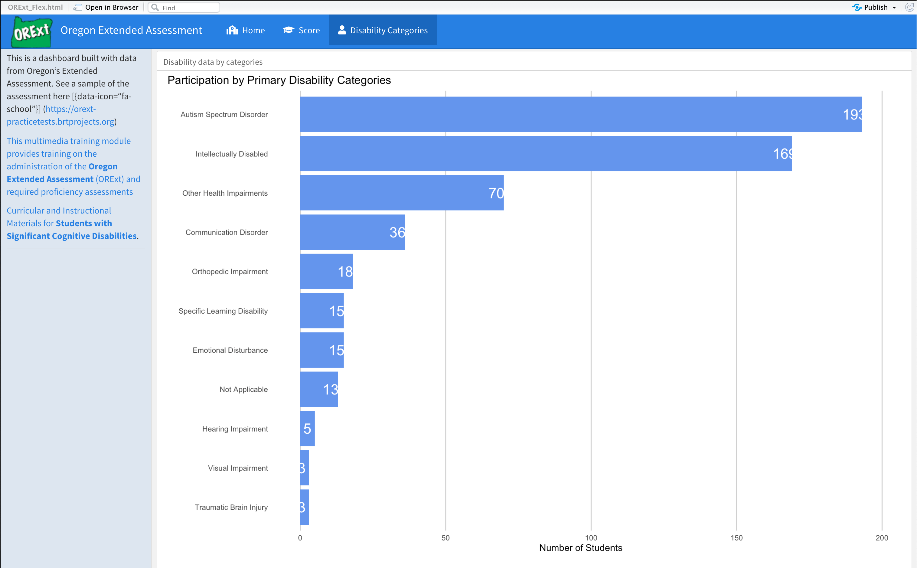
Briefly show each visualization

Slide 5
Pick 1 and Discuss: Intended audience = ODE, Participating Schools, Other States. Design choices, e.g. Colors = Ducks Layout Choice of specific type of plot = Geospatial
Pick one, go more in-depth, and discuss:
Intended audience = Design choices = Colors = Layout = Choice of specific plot =

Slide 6
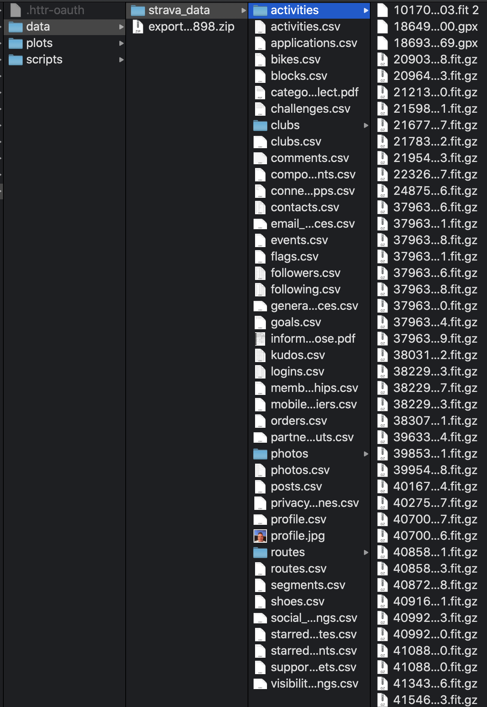
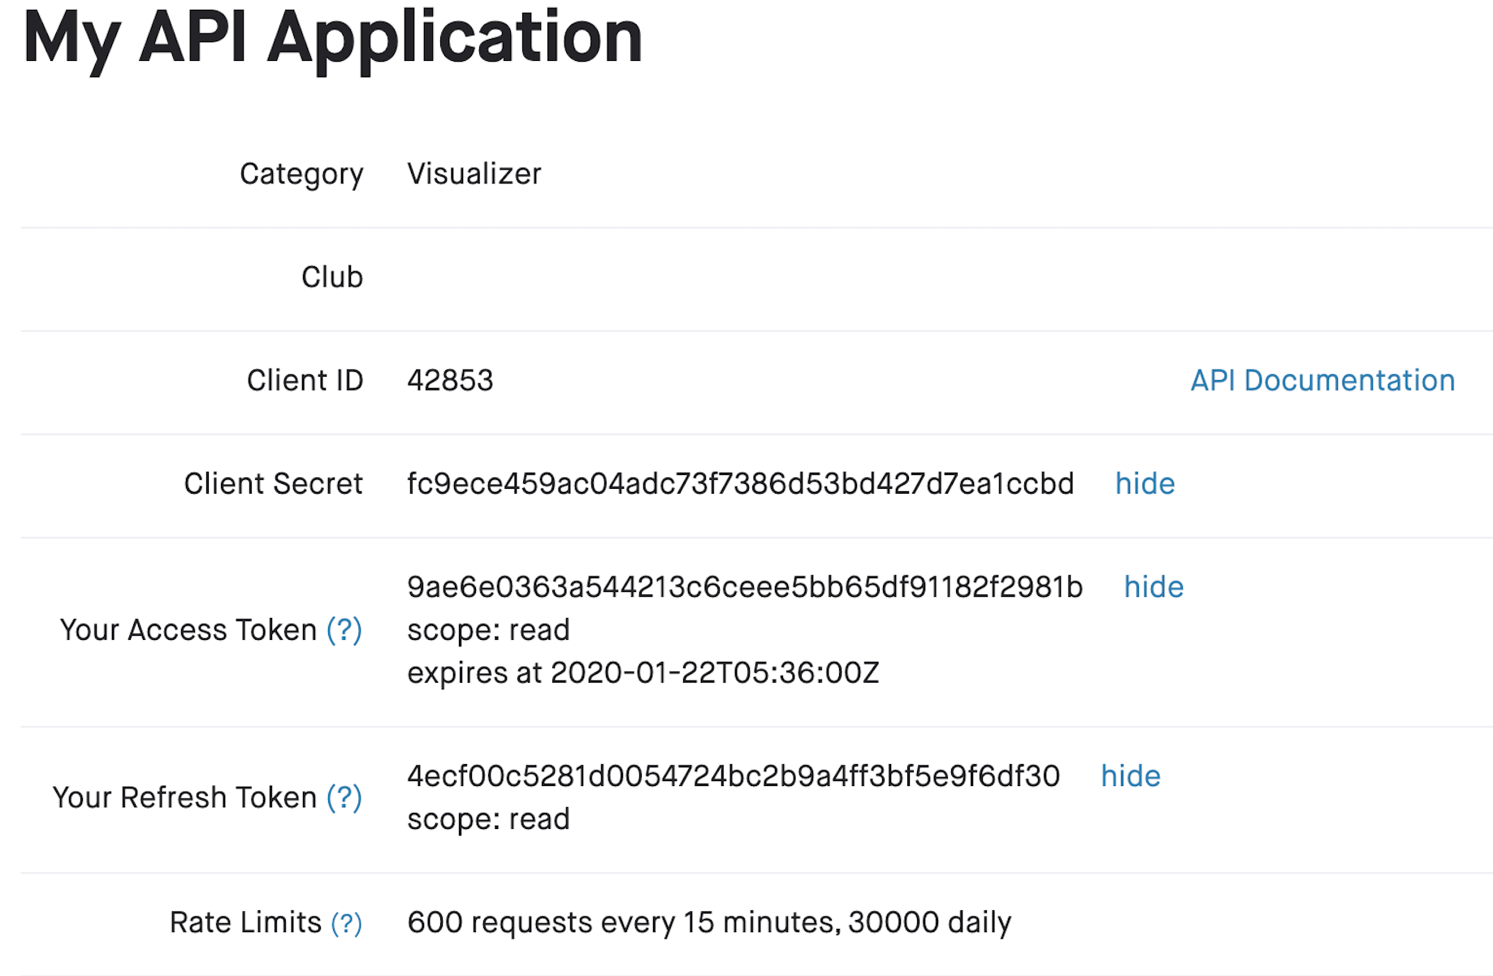
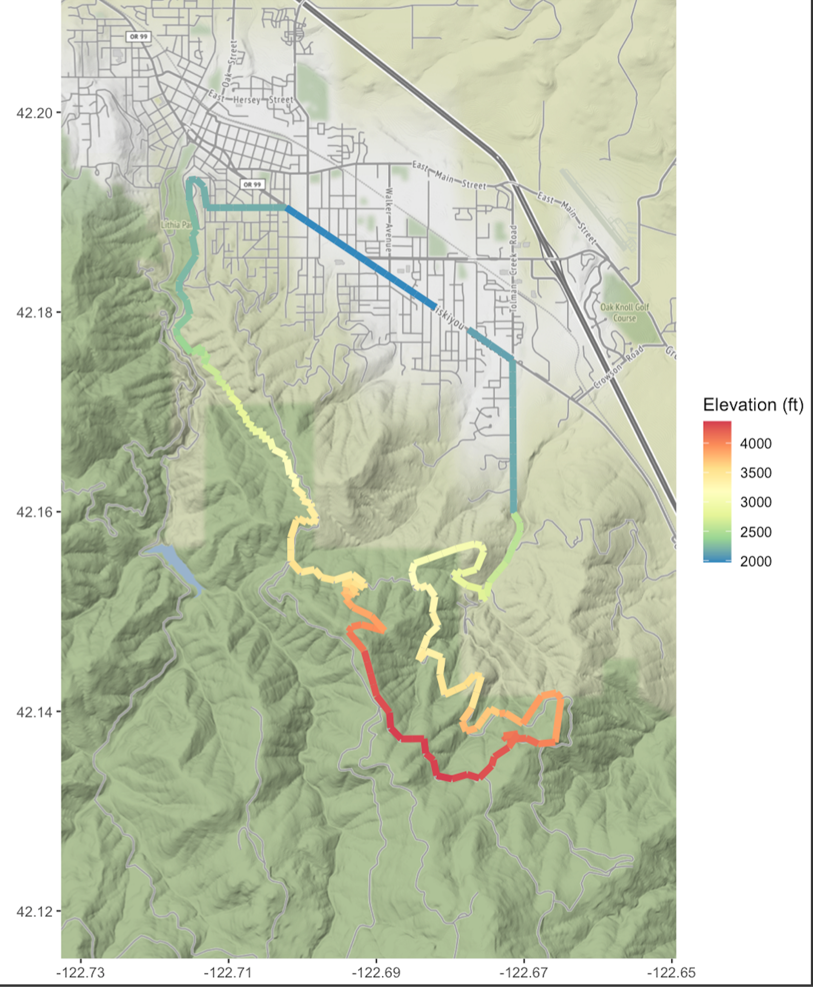
Prior version(s) and how the changes helped clarity, communication, beauty, etc.

Slide 7
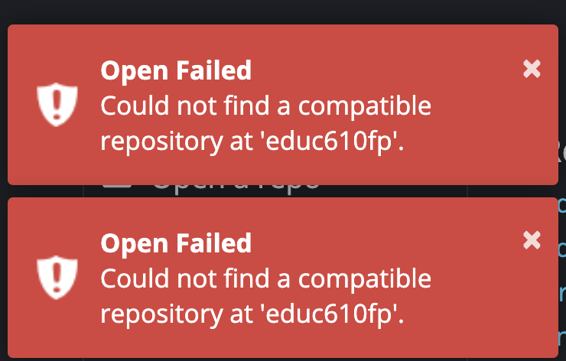
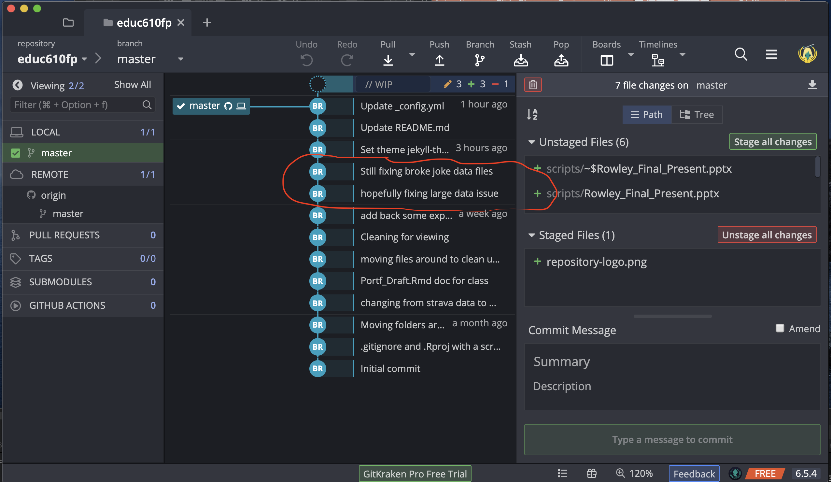
At least 1 major challenge encountered along the way

Slide 8
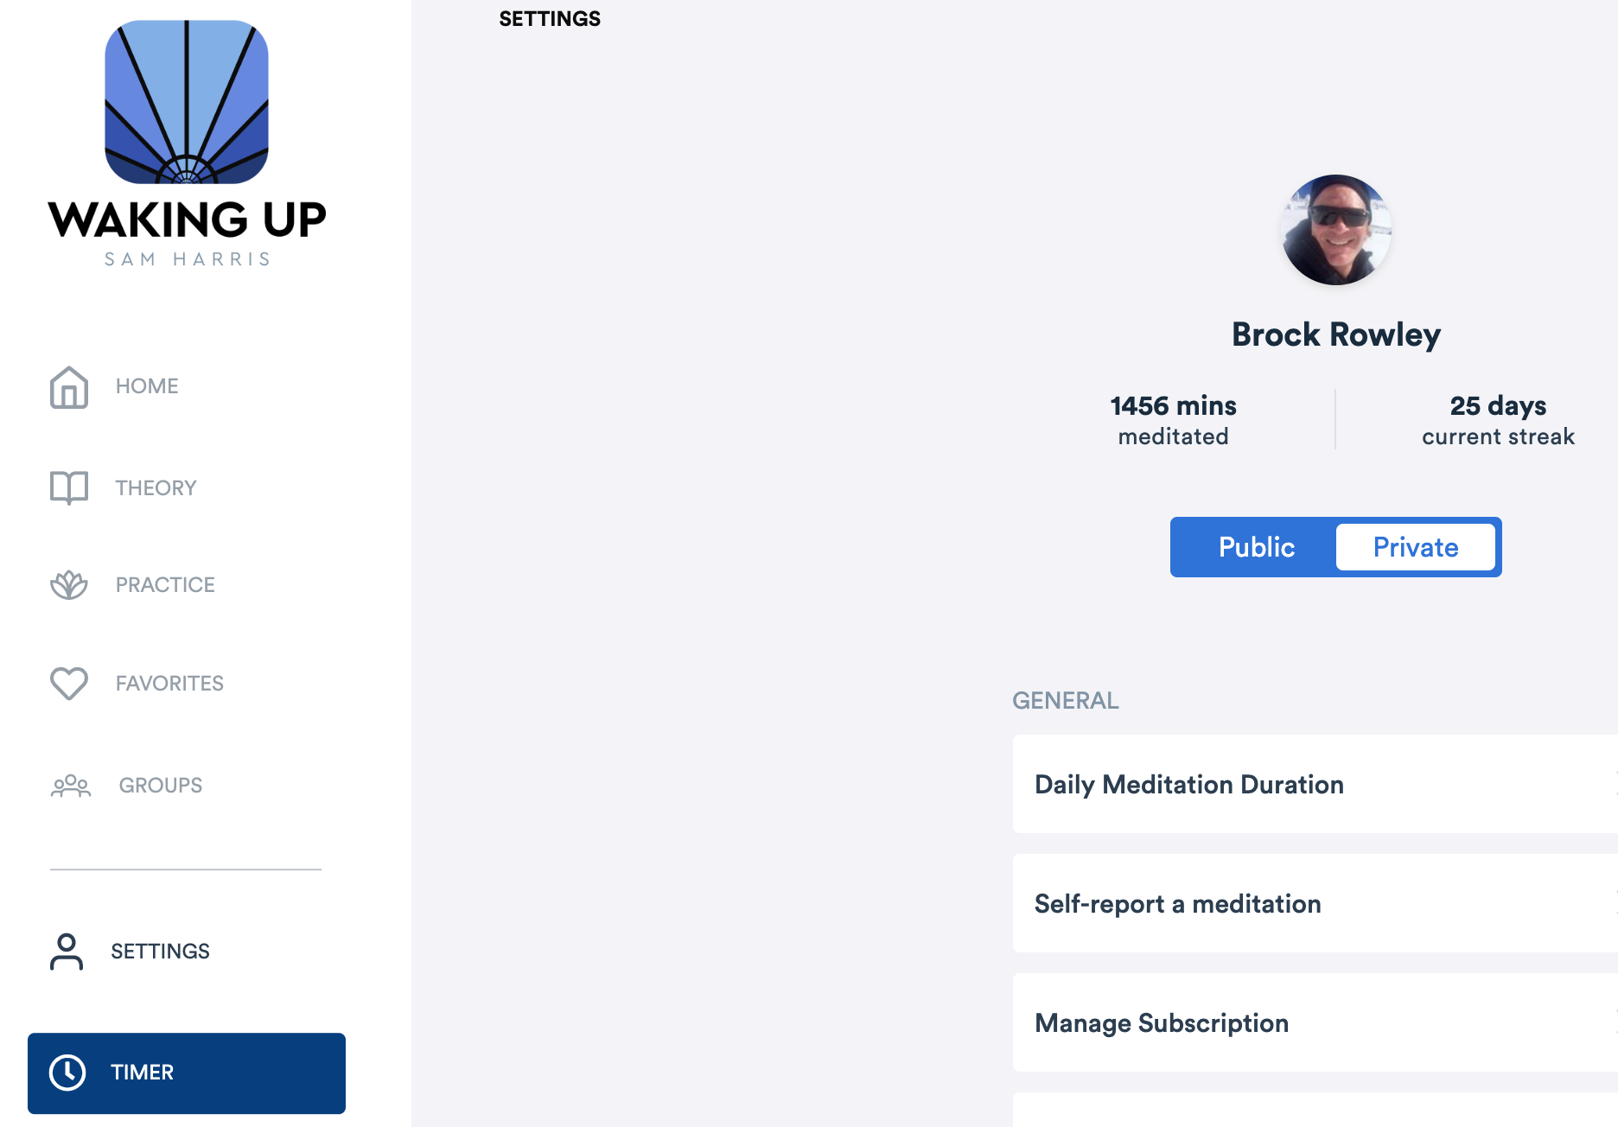
At least 1 major victory

